Slide 1
P5 Intro

Slide 2
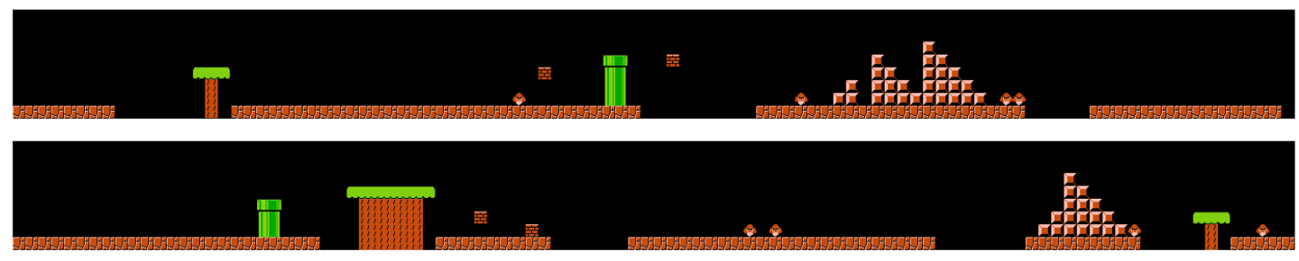
P5: Evolving Mario Levels
Using genetic algorithms to design artifacts.
In this case, we will be generating new Mario levels through evolution.

Slide 3
P5: Evolving Mario Levels
You will be given two encodings of Mario levels as a genome.
Encoding 1: A grid of characters.
Encoding 2: Design elements.
Getting started:
Install numpy and scipy using pip (or pip3)
Install any version of Unity3D
Read this paper:
https://www.researchgate.net/profile/Philippe_Pasquier/publication/220867545_Towards_a_Generic_Framework_for_Automated_Video_Game_Level_Creation/links/0912f510ac2bed57d1000000.pdf

Slide 4
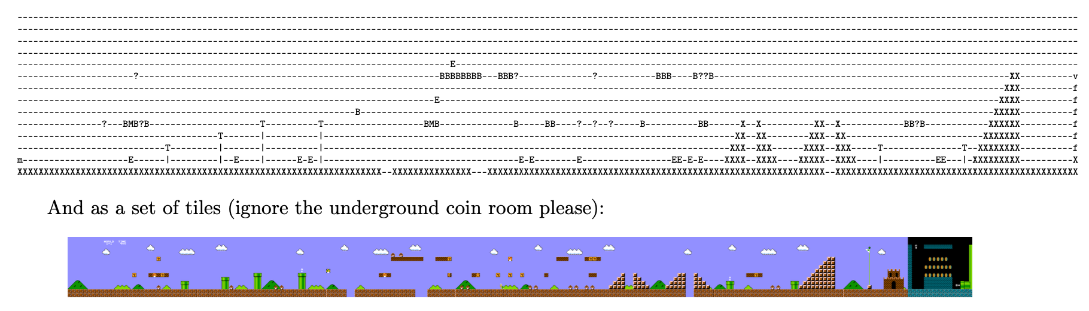
Encoding 1. Grid of Characters
This will just be a txt file. Each unique character refers to an element like a wall, empty space, type of block, etc.

Slide 5
Encoding 1. Grid of Characters
What you will be doing:
Implement the selection, crossover, and mutation.
Use at least two selection strategies to build up the next population.
You may want to improve the fitness function.
You may add new metrics calculations to metrics.py

Slide 6
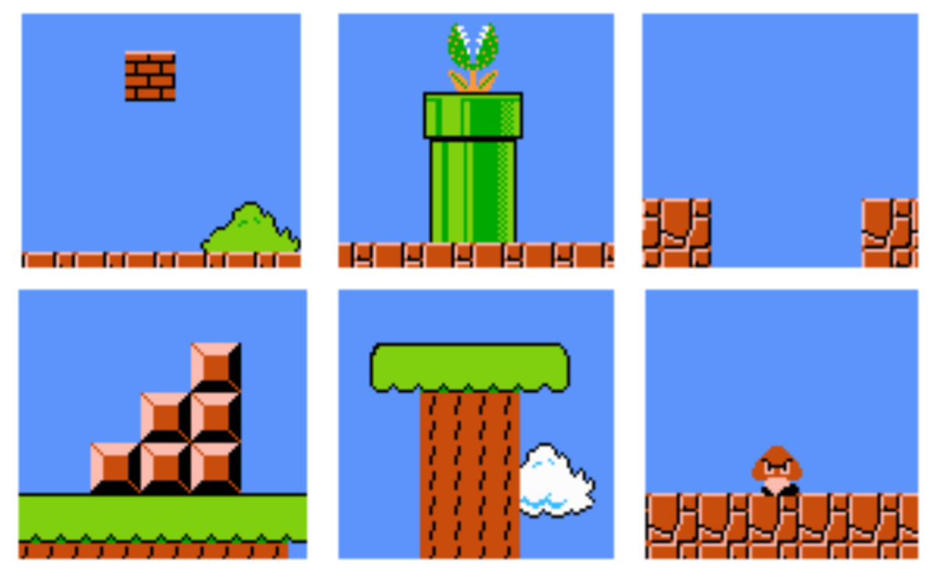
Encoding 2: A set of design elements
A set of design elements instead of a grid of characters like before.
From the paper mentioned earlier.
The genome is implemented with a heap of design elements.
We will be using 8 different design elements.

Slide 7
Encoding 2: A set of design elements
What you will be doing
You are given an implementation of a variable-point crossover. Explain the implementation and why it effectively produces diverse levels with different design elements and different numbers of design elements.
Also, explain how mutation works for this encoding
Try to improve it.
Try to improve the fitness function for this encoding.
You may also want to change the population initialization to encourage biodiversity.

Slide 8
Notes
Use “python ga.py” to start the genetic algorithm and produce levels, hit ctrl-c when you’re done
Switch to encoding 2 by changing the line “Individual = Individual_Grid” to “Individual = Individual_DE”
Do some research on different methods for selection, crossover, etc.
You will be modifying ga.py. The functions you will be changing or observing will be marked STUDENT.

Slide 9
Team Competition
If your team wants to compete in the level generation contest, say so in your writeup
The team with the best level will earn extra credit
Every competing team must play other team’s games and submit their ratings (in a separate submission on Canvas, later on)

